Slide 1

EditEdittex
Lecture 1: Constructor

Slide 2

Today’s Agenda
Today we are going to cover -
Constructor
Types of Constructor
Default Constructor
Parameterized Constructor
Copy Constructor
Practice Question

Slide 3
Let’s Get Started-

Slide 4
Constructor
A constructor is a member function of a class which initializes objects of a class. In C++, Constructor is automatically called when object(instance of class) create. It is special member function of the class.
Constructor has same name as the class itself
Constructors don’t have return type
A constructor is automatically called when an object is created.
If we do not specify a constructor, C++ compiler generates a default constructor for us (expects no parameters and has an empty body).

Slide 5
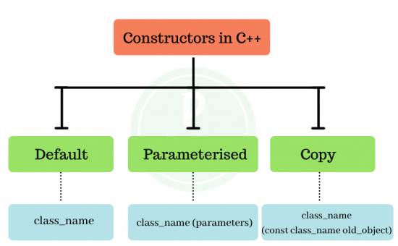
Types of constructor

Slide 6
Default Constructor
1. Default Constructors: Default constructor is the constructor which doesn’t take any argument. It has no parameters.
class construct
{
public:
int a, b;
// Default Constructor
construct()
{
a = 10;
b = 20;
}
};

Slide 7
Default Constructor
int main()
{
// Default constructor called automatically
// when the object is created
construct c;
cout << "a: " << c.a << endl
<< "b: " << c.b;
return 1;
}

Slide 8
Default Constructor
int main()
{
// Default constructor called automatically
// when the object is created
construct c;
cout << "a: " << c.a << endl
<< "b: " << c.b;
return 1;
}

Slide 9
Output
a: 10
b: 20

Slide 10
Output
a: 10
b: 20
Even if we do not define any constructor explicitly, the compiler will automatically provide a default constructor implicitly.

Slide 11
Parameterized Constructors
It is possible to pass arguments to constructors. Typically, these arguments help initialize an object when it is created. To create a parameterized constructor, simply add parameters to it the way you would to any other function. When you define the constructor’s body, use the parameters to initialize the object.

Slide 12
Parameterized Constructors
It is possible to pass arguments to constructors. Typically, these arguments help initialize an object when it is created. To create a parameterized constructor, simply add parameters to it the way you would to any other function. When you define the constructor’s body, use the parameters to initialize the object.

Slide 13
Parameterized Constructors
class Point
{
private:
int x, y;
public:
// Parameterized Constructor
Point(int x1, int y1)
{
x = x1;
y = y1;
}

Slide 14
Parameterized Constructors
int getX()
{
return x;
}
int getY()
{
return y;
} };
int main()
{
// Constructor called
Point p1(10, 15);
cout << "p1.x = " << p1.getX() << ", p1.y = " << p1.getY();
return 0;
}

Slide 15
Parameterized Constructors
p1.x = 10, p1.y = 15
When an object is declared in a parameterized constructor, the initial values have to be passed as arguments to the constructor function. The normal way of object declaration may not work. The constructors can be called explicitly or implicitly.
Example e = Example(0, 50); // Explicit call Example e(0, 50); // Implicit call
We can have more than one constructor in a class it is called constructor overloading.

Slide 16
Uses of Parameterized Constructor
It is used to initialize the various data elements of different objects with different values when they are created.
It is used to overload constructors.

Slide 17
Copy Constructor
Copy Constructor: A copy constructor is a member function which initializes an object using another object of the same class.
Whenever we define one or more non-default constructors( with parameters ) for a class, a default constructor( without parameters ) should also be explicitly defined as the compiler will not provide a default constructor in this case. However, it is not necessary but it’s considered to be the best practice to always define a default constructor.

Slide 18
Copy Constructor
class point
{
private:
double x, y;
public:
// Non-default Constructor &
// default Constructor
point (double px, double py)
{
x = px, y = py;
}
};

Slide 19
Copy Contstructor
int main(void)
{
// Define an array of size
// 10 & of type point
// This line will cause error
point a[10];
// Remove above line and program
// will compile without error
point b = point(5, 6);
}

Slide 20
Output
Error: point (double px, double py): expects 2 arguments, 0 provided

Slide 21
Output
Error: point (double px, double py): expects 2 arguments, 0 provided

Slide 22
MCQ 1
Which of the followings is/are automatically added to every class, if we do not write our own.
(A) Copy Constructor
(B) Assignment Operator
(C) A constructor without any parameter
(D) All of the above

Slide 23
MCQ 1
Which of the followings is/are automatically added to every class, if we do not write our own.
(A) Copy Constructor
(B) Assignment Operator
(C) A constructor without any parameter
(D) All of the above

Slide 24
MCQ 2
#include<iostream>
using namespace std;
class Point {
Point() { cout << "Constructor called"; }
};
int main()
{
Point t1;
return 0;
}
(A) Compiler Error
(B) Runtime Error
(C) Constructor called

Slide 25
MCQ 2
#include<iostream>
using namespace std;
class Point {
Point() { cout << "Constructor called"; }
};
int main()
{
Point t1;
return 0;
}
(A) Compiler Error
(B) Runtime Error
(C) Constructor called

Slide 26
Guess the output 1
class A{
mutable int a;
public:
A(){
cout<<"Default constructor called\n";
}
A(const A& a){
cout<<"Copy Constructor called\n";
}
};
int main(int argc, char const *argv[])
{
A obj;
A a1 = obj;
A a2(obj);
}

Slide 27
Guess the output 1
Default constructor called
Copy Constructor called
Copy Constructor called

Slide 28
Guess the output 2
class A{
mutable int a;
public:
A(){
cout<<"A's default constructor called\n";
}
A(const A& a){
cout<<"A's copy Constructor called\n";
}
};
class B{
A obj;
public:
B(){
cout<<"B's Constructor called\n";
}
};

Slide 29
Guess the output 2
int main(int argc, char const *argv[])
{
B b1;
B b2;
}

Slide 30
Guess the output 2
A's default constructor called
B's Constructor called
A's default constructor called
B's Constructor called

Slide 31

QNA Time
Any Questions??
Any Questions ??

Slide 32
Thank You!
See you guys in next class.

